Slide 1


Slide 2

hello

Slide 3
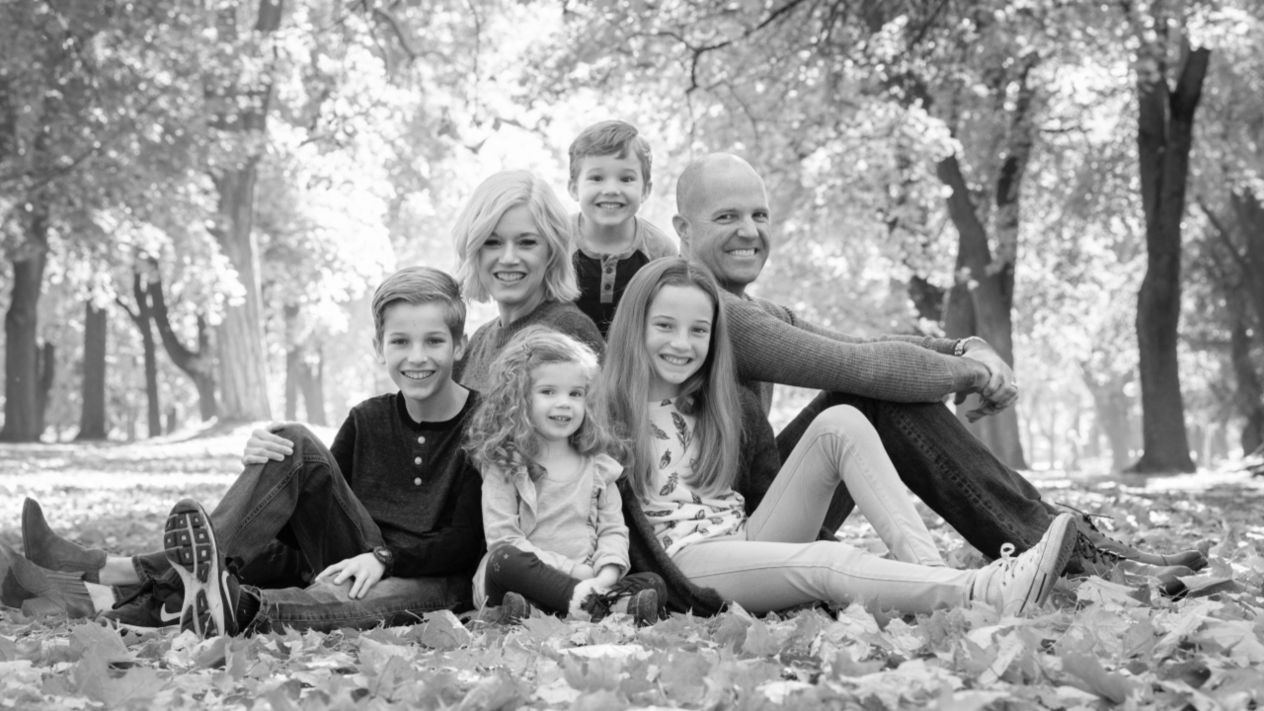

Slide 4

Why set and achieve
impossible goals?

Slide 5



Because it’s

Slide 6
NOT because it will make you any more amazing than you already are

Slide 7
Most people will not achieve impossible goals in their lifetime

Slide 8

1. The goal is IMPOSSIBLE
2. They are not willing to fail
3. They are not willing to be uncomfortable
4. They think it’s just too hard
5. They think they need to know how
6. They aren’t believing hard enough
7. They are past focused instead of future focused

Slide 9
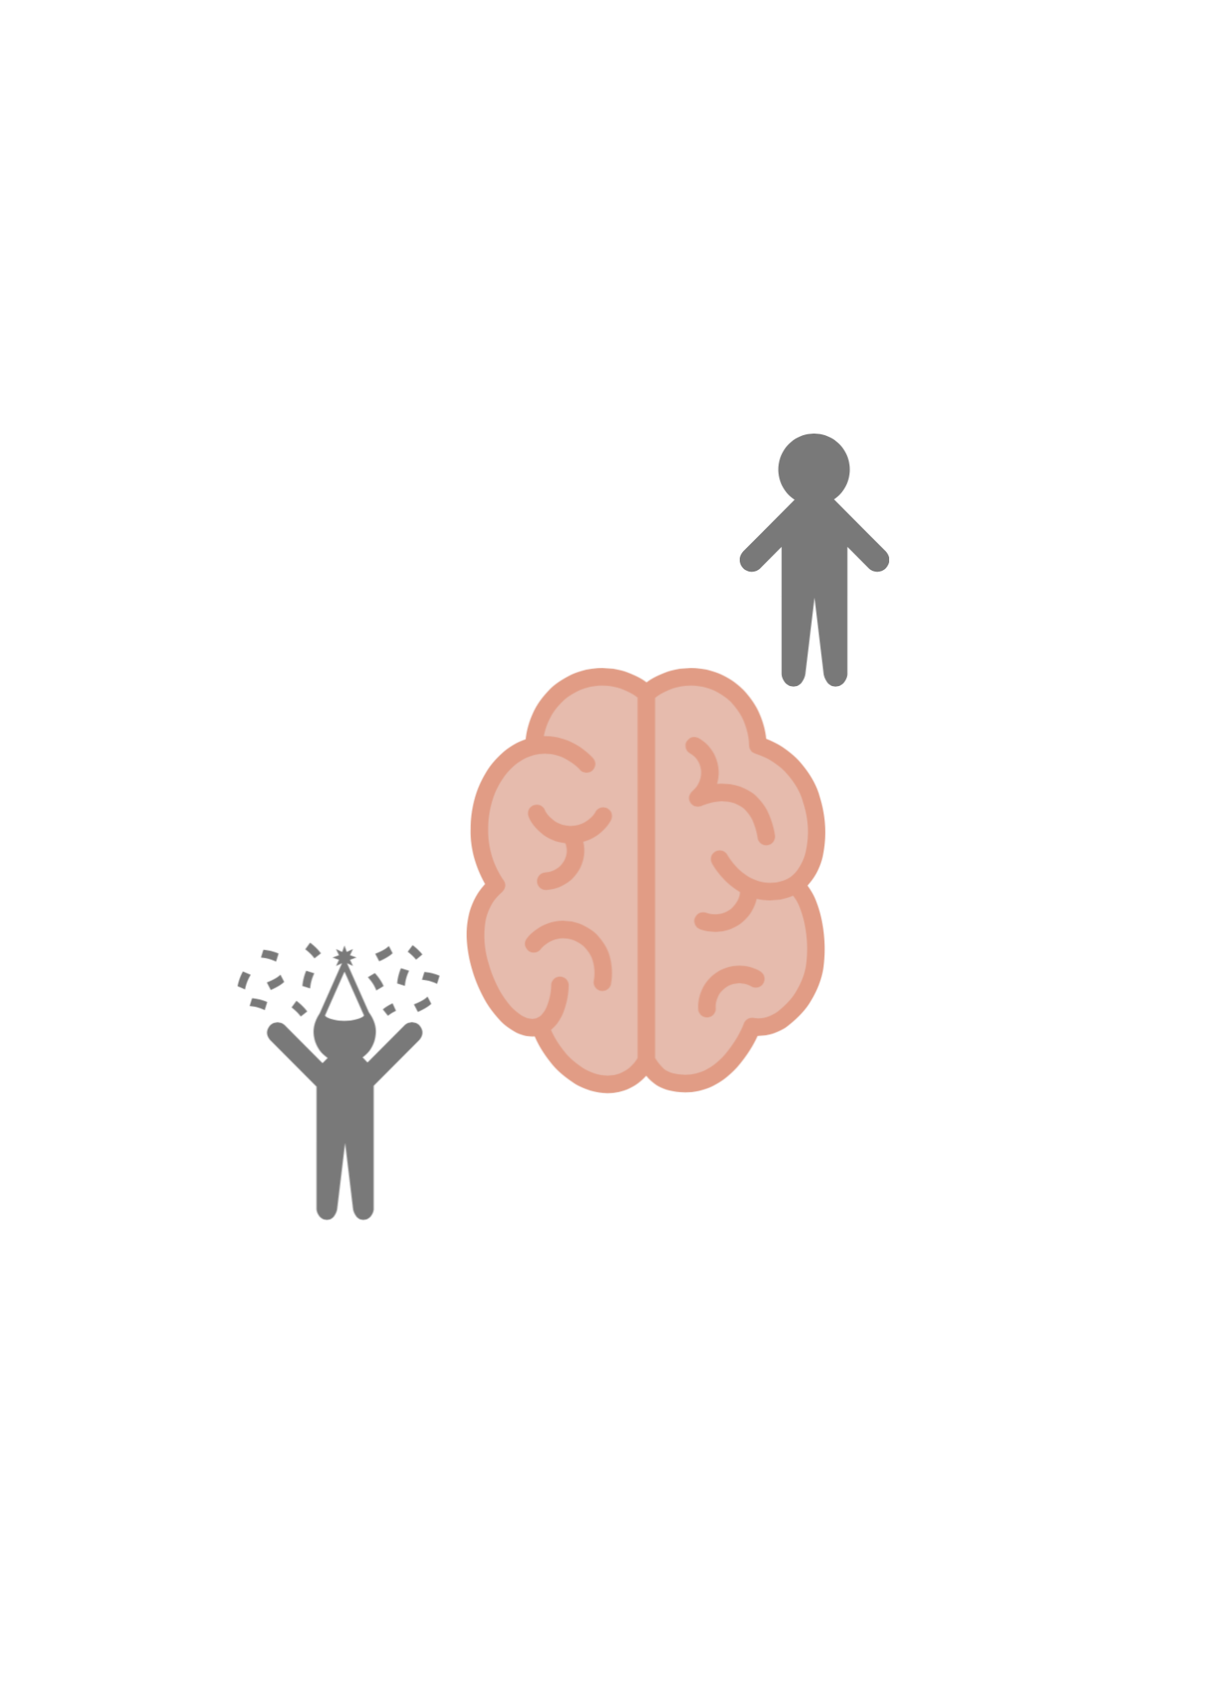
The Human Brain

Slide 10


Why try? It’s impossible.
one
You’re right. What was I thinking?
The goal is IMPOSSIBLE

Slide 11

BUT WHAT IF IT IS POSSIBLE?

Slide 12
But we could fail. And that would suck.
two
You’re right. Let’s turn back now.
They are not
willing to fail

Slide 13

I’D RATHER TRY AND FAIL
THEN FAIL AHEAD OF TIME

Slide 14
I don’t feel like it.
three
Good point. Let’s do something else instead.
They are not willing to be uncomfortable

Slide 15

YOU DON’T HAVE TO FEEL LIKE IT.
JUST DO IT ANYWAY

Slide 16
It’s really hard.
four
True.
I give up.
They think it’s
too hard

Slide 17

SO WHAT THAT IT’S HARD?

Slide 18
I don’t know how.
five
They think they need to know how
That is true.

Slide 19

OF COURSE NOT
BUT WHAT’S THE NEXT STEP?

Slide 20
I’m not sure I can do this.
six
They aren’t believing hard enough
I know, right?

Slide 21

OF COURSE I CAN.
IT’S AS GOOD AS DONE

Slide 22
I’ve never been able to do it before.
seven
They are past focused instead of future focused
Good point.

Slide 23

THAT’S IN THE PAST. LET’S
THINK ABOUT THE FUTURE

Slide 24


The you who has already achieved your goal.

Slide 25

How does she dress. What does her home look like?

Slide 26

What does he believe about your ability to do this?

Slide 27

What does she think about your current problem?

Slide 28

What would he say to you when you’ve failed?

Slide 29

What decision does she make in any given situation?

Slide 30
Become your future self now. You’re allowed.

Slide 31



Better Than Happy
@jodymoorecoaching
JODYMOORE.COM

