Slide 1
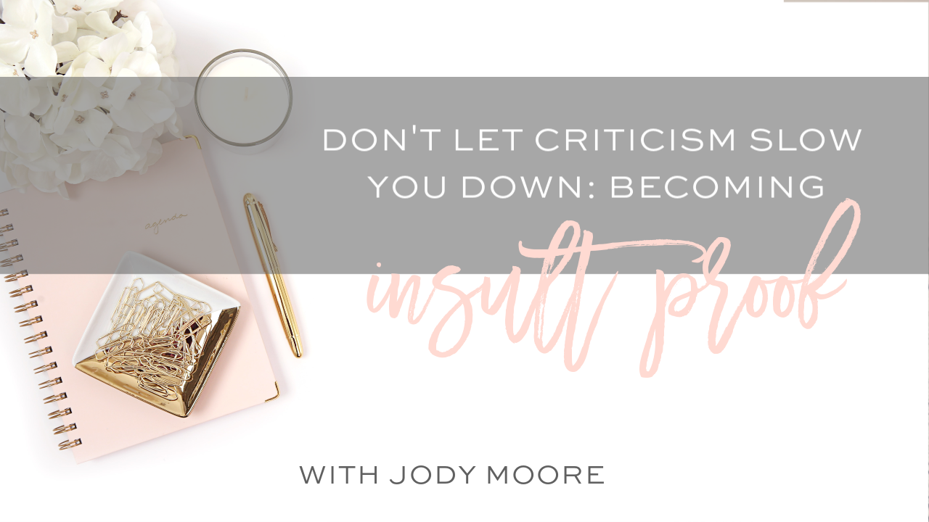

Slide 2

hello

Slide 3
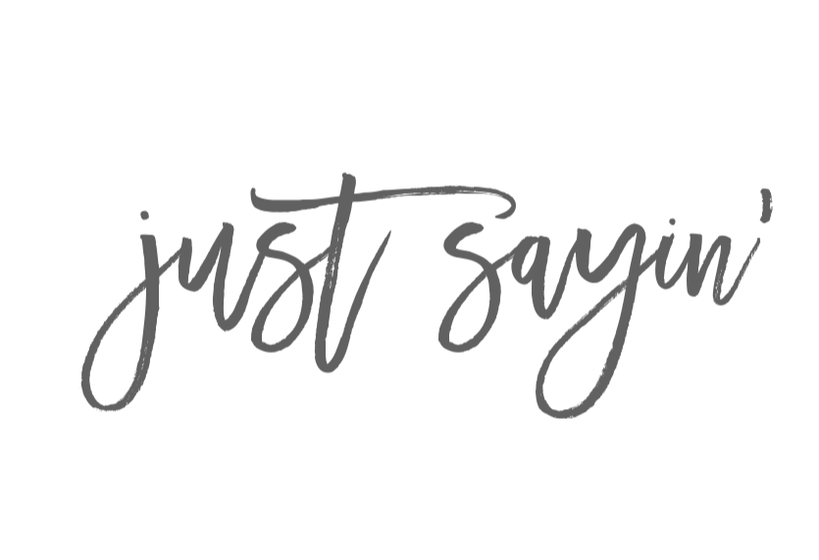


I love school buses

Slide 4

The way we think the world works:
We receive a critical email or comment.
We feel hurt or annoyed or frustrate.

Slide 5
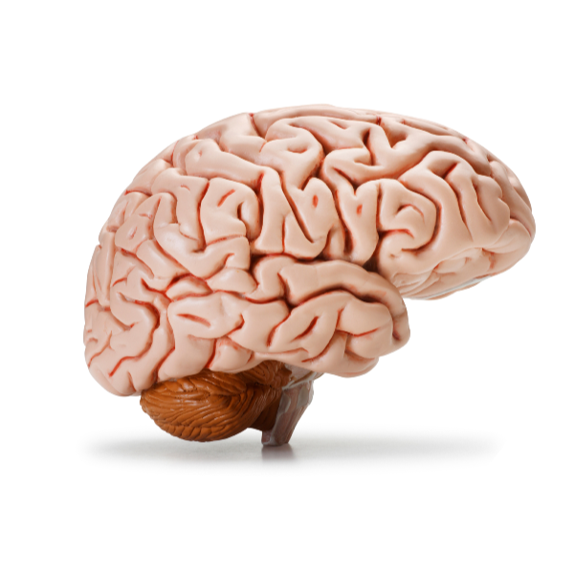
The way the world really works:
We receive a critical email or comment.
We make it mean something with our thoughts.
We feel hurt or annoyed or frustrate.

Slide 6
How would you feel if you had received my school bus criticism?

Slide 7
We learn from a young age that things outside of us create our feelings

Slide 8
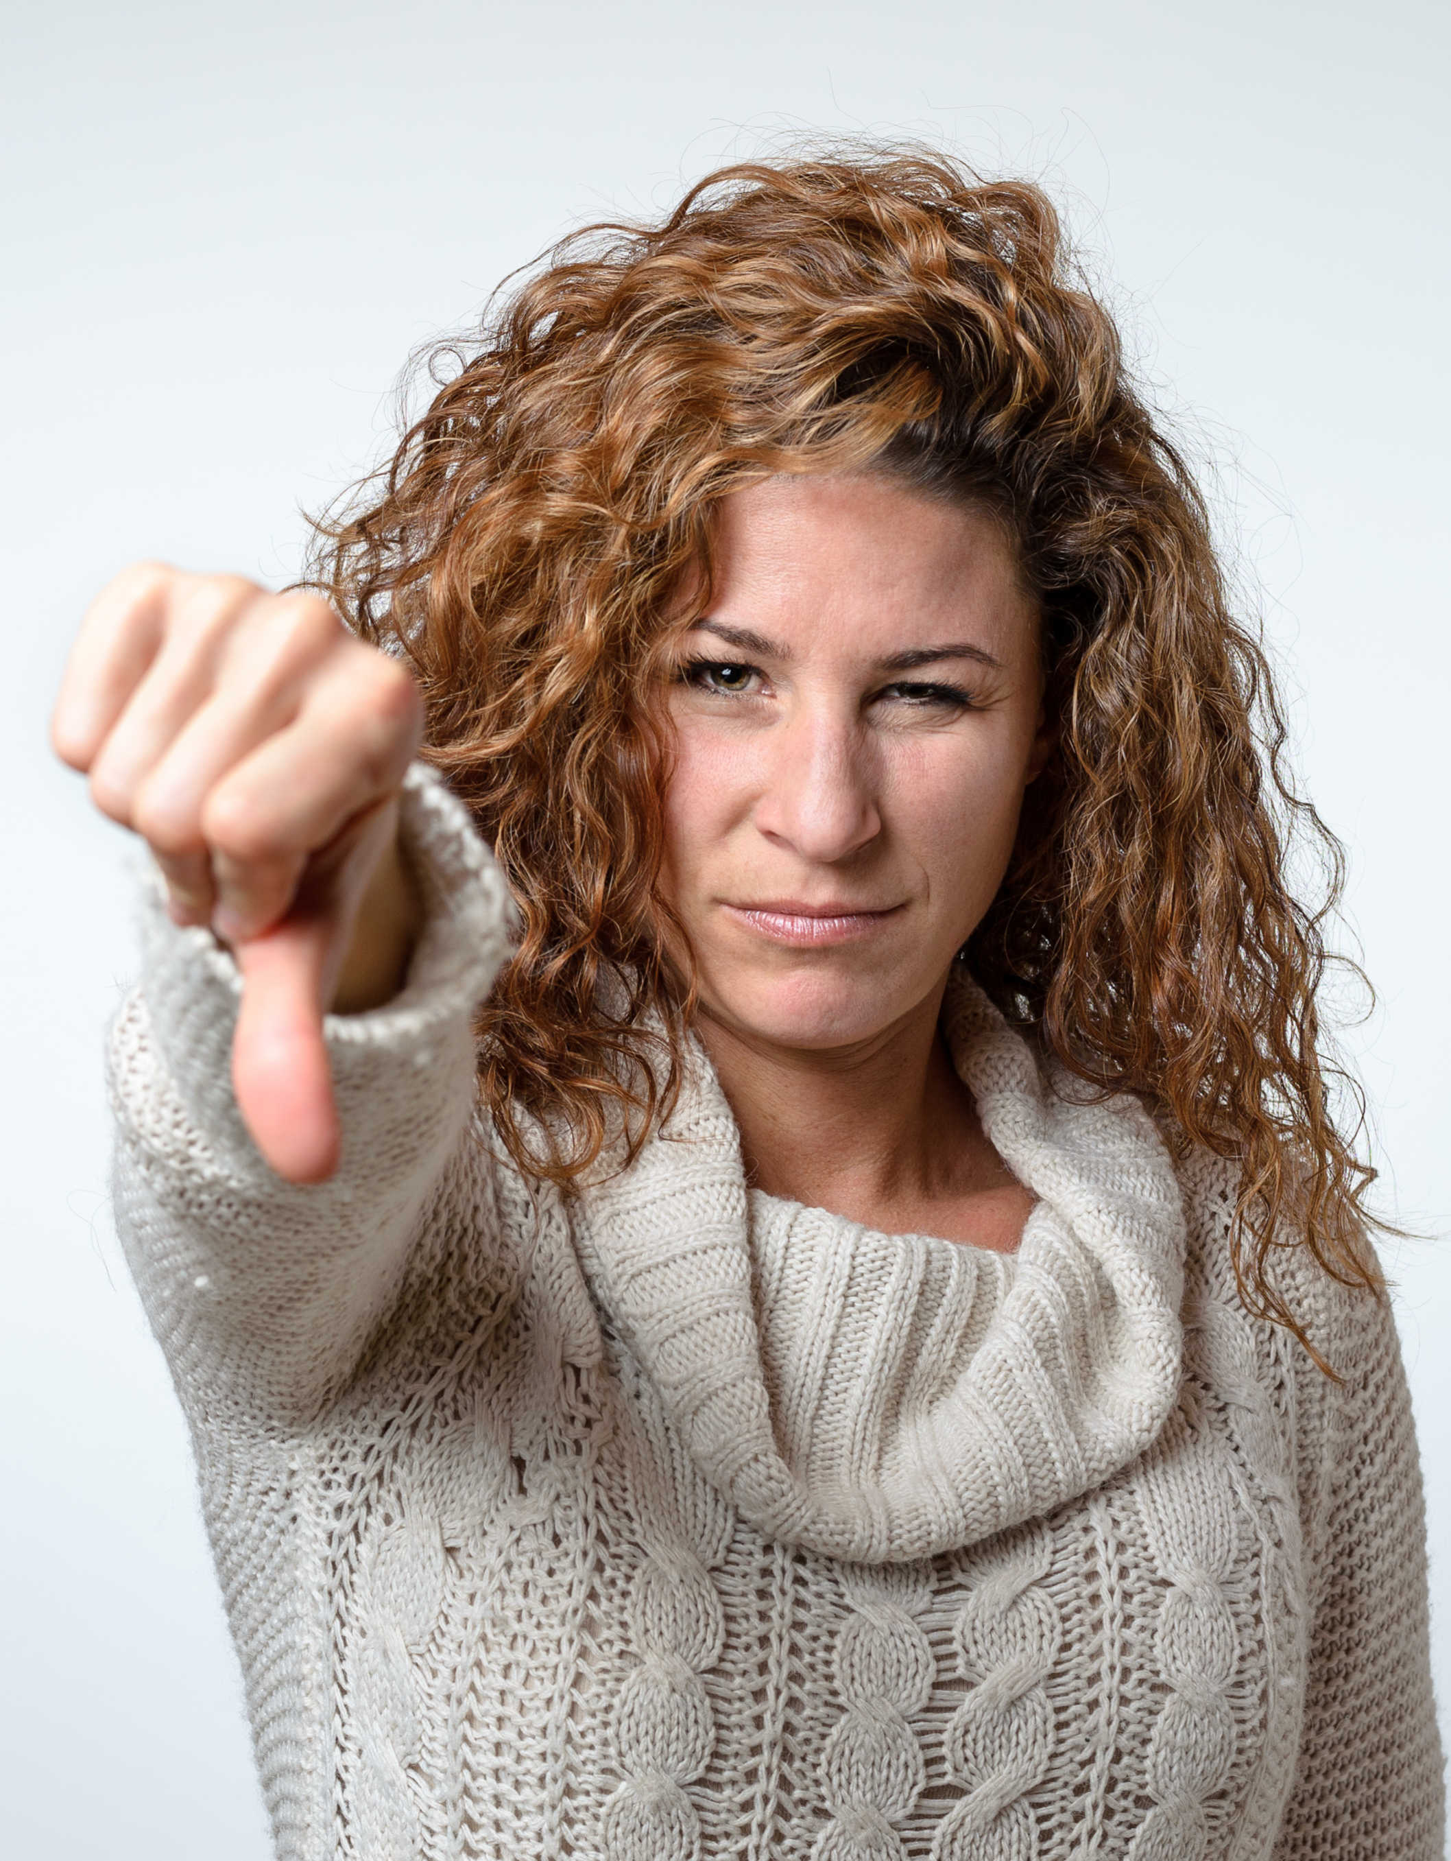

Negative comments hurt

Slide 9
I understand what it’s like to feel hurt

Slide 10
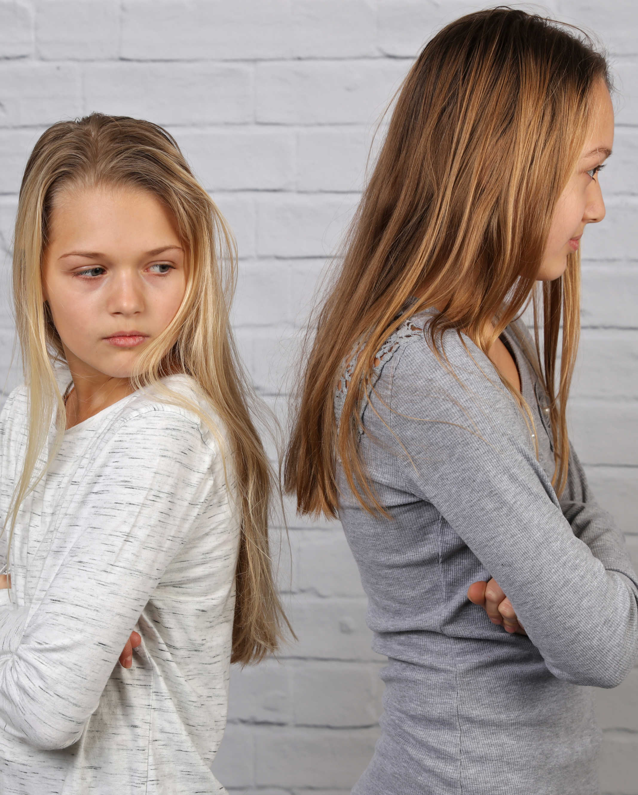

Don’t hurt your sister’s feelings

Slide 11
You are a nice girl and it’ll always feel best to be nice to others

Slide 12
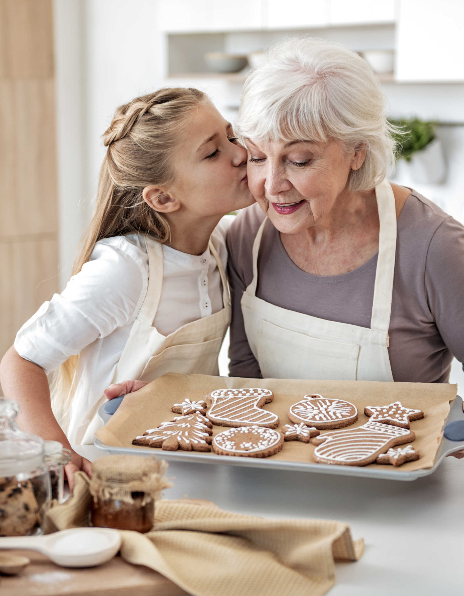

You made Grandma so happy today

Slide 13

I know Grandma enjoyed spending time with you today

Slide 14
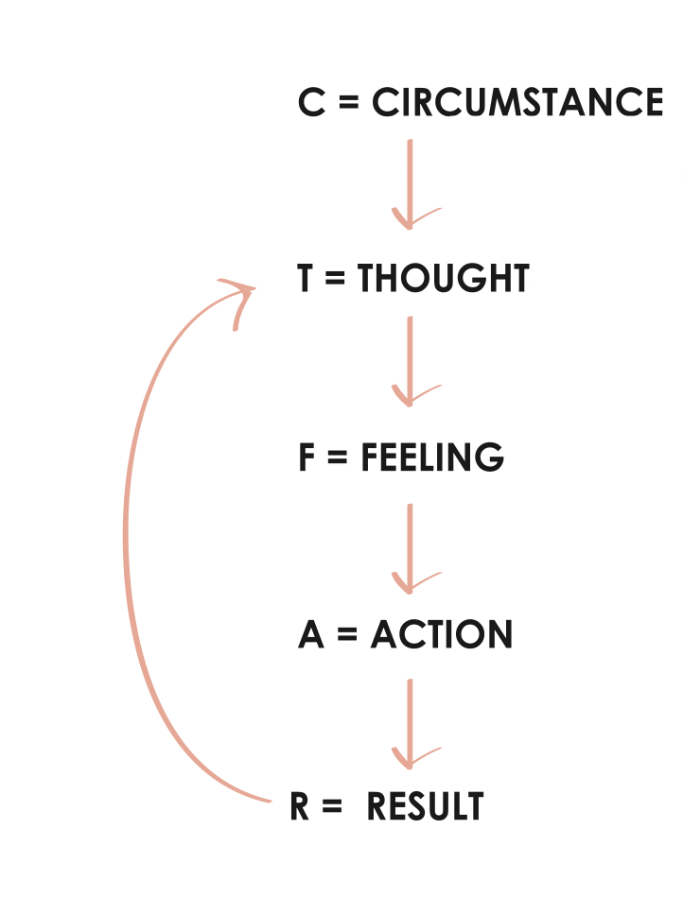
The facts that happen outside of us.
The meaning we give to our circumstances.
The vibrations in our bodies that drive our actions.
What we do or don’t do. The way we show up.
How our actions play out for us in our lives.

Slide 15
CIRCUMSTANCE:
“Your life seems out of balance and not in favor of your kids.”
THOUGHT:
She shouldn’t judge me
FEELING:
Defensive
ACTION:
Story fondle
RESULT:
I’m very judgmental of her and not who I want to be

Slide 16

Feelings matter.

Slide 17

Building a business is not easy.
You’ll need the right fuel.

Slide 18
defensiveness
Story fondling
Podcast episode on judgement
Thinking about the 2%
Focus on us instead of clients/customers
Not inspired to create
Stop sharing or water it down

Slide 19


x
x
Try to control the

Slide 20


x
x
Choose what we want to

Slide 21
CIRCUMSTANCE:
“Your life seems out of balance and not in favor of your kids.”
THOUGHT:
She has my permission to be wrong about me
FEELING:
Confident
ACTION:
Move on
RESULT:
I keep control of being who I want to be

Slide 22
What other people think of you is not about you. It’s about them.

Slide 23

Girl, Wash
Your Face
BY RACHEL HOLLIS

Slide 24
More criticism is a sign of more success.

Slide 25
Don’t take advice from anyone who isn’t playing the game.

Slide 26

If you’re not in the arena also getting your ass kicked, I’m not interested in your feedback.
- Brene Brown

Slide 27
Don’t fall for the lies your brain will try to tell you

Slide 28

If you were better at this, everyone would like it..

Slide 29

Once I am more successful, this stuff won’t bother me.

Slide 30

But should you reply?

Slide 31

Your ideal client might have the same question
It feels kind and compassionate to reply
Your head is in the right place

Slide 32
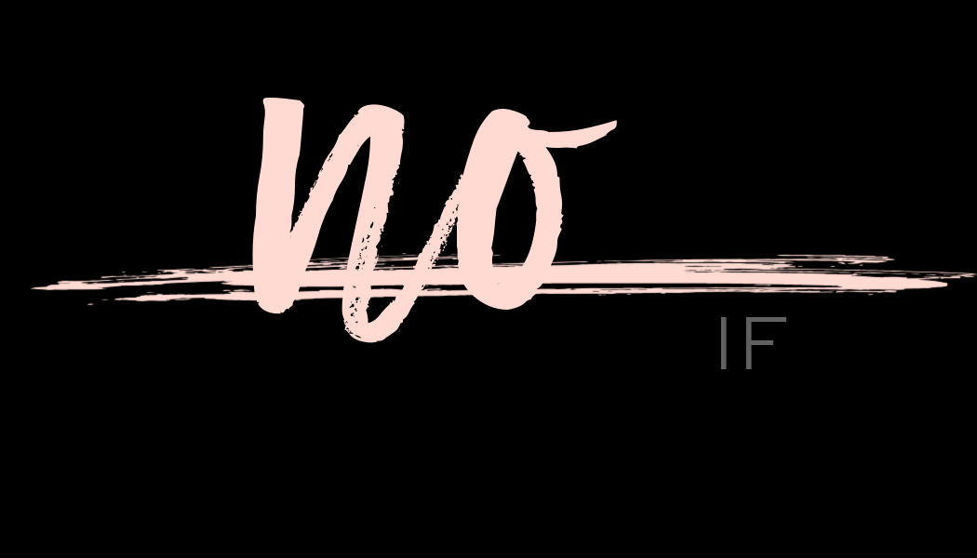
Part of you hopes to change their mind
You are giving attention to what you don’t want
You feel defensive or hurt as you do so

Slide 33
Be brief in your reply

Slide 34

I’m not sure I can handle this part..

Slide 35
Do hard things and your life will be easy. Do easy things and your life will be hard.

Slide 36



Better Than Happy
@jodymoorecoaching
JODYMOORE.COM

